Slide 1
Design and analysis of algorithms
Weiwei Wu(吴巍炜)

Slide 2
Design and analysis of algorithms
-- Introduction to Algorithmic Thinking
Weiwei Wu(吴巍炜)

Slide 3
Mobile System, mechanism design and competitiveness
Weiwei Wu(吴巍炜)
http://cse.seu.edu.cn/people/weiweiwu
About me
CityU
USTC
2011, PhD, Hong Kong
NTU
2012, Postdoc, Singapore
SEU
2012, Associate professor
weiweiwu@seu.edu.cn
Notes:
Combinatorial Optimization in Action
Flying a plane, riding a bus, buying a writing pad, or making a
phone call: Can you imagine that combinatorial optimization has
something to do with these activities? This lecture will provide
answers and show how the techniques of discrete mathematics
influence our daily life.
Combinatorial optimization in action
Combinatorial optimization exploded on the mathematical and scientific scene in the 1950s. In this lecture I will briefly survey its development for a wide audience. Theoretical design and analysis of algorithms dominated the early development of the field, while computational progress has been particularly significant in the last twenty years. These theoretical and computational achievements, combined with successful modeling of applications, have made it possible today to solve real-world problems of breathtaking size and diversity. The majority of the lecture will report on success stories in areas such as telecommunication, transportation, traffic and logistics. These results are based on ongoing cooperation between industry, the DFG Research Center MATHEON and my research group at Konrad-Zuse-Zentrum (ZIB).

Slide 4
Our team on optimizations
Weiwei Wu(吴巍炜), PhD, Associate Professor
http://cse.seu.edu.cn/people/weiweiwu
About us
Xiaolin Fang(方效林), PhD, Assistant Professor
http://cse.seu.edu.cn/people/xiaolin
Shan Feng(单冯), PhD, Assistant Professor
http://dblp.uni-trier.de/pers/hd/s/Shan:Feng

Slide 5
Team on optimizations
Studied topics: ALG in computer science
optimizations
wireless communication
cloud computing
crowdsourcing
game theory and network economics
artificial intelligence
About us

Slide 6
Recruiting
Masters under supervision
on optimizations & reinforcement learning
Requirements:
  a) SEU-Monash/SE interested in Research/AI algorithms
  b) Programming skills
  c) For Nanjing
Contact: weiweiwu@seu.edu.cn
15195942422

Slide 7
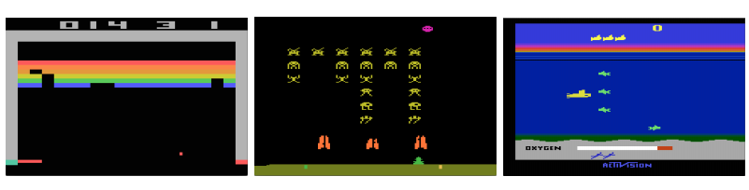
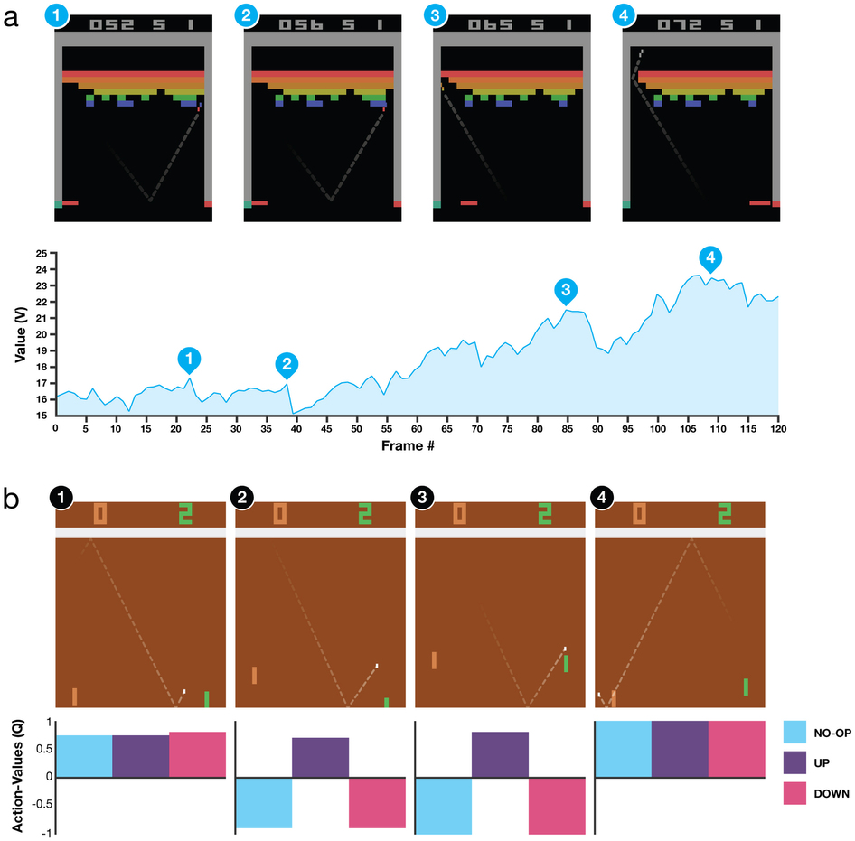
About project: gaming with reinforcement learning
Short-term plan:
Project on reinforcement learning
Requirements:
  a) programming skills/project experience
  b) interests in artificial intelligence
gaming with reinforcement

Slide 8
About project: gaming with reinforcement learning
Result:
Project on reinforcement learning
Requirements:
  a) programming skills/project experience
  b) interests in artificial intelligence
gaming with reinforcement

Slide 9

About project: gaming with reinforcement learning
Video:
Project on reinforcement learning
Requirements:
  a) programming skills/project experience
  b) interests in artificial intelligence
gaming with reinforcement
Video:
http://www.nature.com/nature/journal/v518/n7540/fig_tab/nature14236_SV2.html
http://www.nature.com/nature/journal/v518/n7540/fig_tab/nature14236_SV2.html

Slide 10
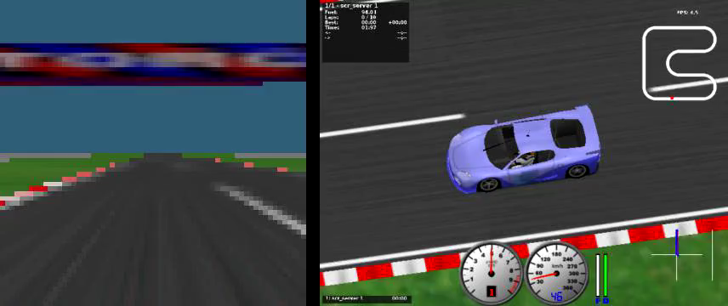
About project: gaming with reinforcement learning
Video:
Project on reinforcement learning
Requirements:
  a) programming skills/project experience
  b) interests in artificial intelligence
gaming with reinforcement
Video:
http://www.nature.com/nature/journal/v518/n7540/fig_tab/nature14236_SV2.html
http://www.nature.com/nature/journal/v518/n7540/fig_tab/nature14236_SV2.html

Slide 11
ADAAPT: A Deep Architecture for Adaptive Policy Transfer from Multiple Sources, J. Rajendran et al., arXiv, 2015.
Variational Information Maximisation for Intrinsically Motivated Reinforcement Learning, S. Mohamed and D. J. Rezende, arXiv, 2015.
Deep Reinforcement Learning with Double Q-learning, H. van Hasselt et al., arXiv, 2015.
Continuous control with deep reinforcement learning, T. P. Lillicrap et al., arXiv, 2015.
Language Understanding for Text-based Games Using Deep Reinforcement Learning, K. Narasimhan et al., EMNLP, 2015.
Giraffe: Using Deep Reinforcement Learning to Play Chess, M. Lai, arXiv, 2015.
Action-Conditional Video Prediction using Deep Networks in Atari Games, J. Oh et al., NIPS, 2015.
Learning Deep Neural Network Policies with Continuous Memory States, M. Zhang et al., arXiv, 2015.
Deep Recurrent Q-Learning for Partially Observable MDPs, M. Hausknecht and P. Stone, arXiv, 2015.
Listen, Attend, and Walk: Neural Mapping of Navigational Instructions to Action Sequences, H. Mei et al., arXiv, 2015.
Incentivizing Exploration In Reinforcement Learning With Deep Predictive Models, B. C. Stadie et al., arXiv, 2015.
End-to-End Training of Deep Visuomotor Policies, S. Levine et al., arXiv, 2015.
DeepMPC: Learning Deep Latent Features for Model Predictive Control, I. Lenz, et al., RSS, 2015.
Universal Value Function Approximators, T. Schaul et al., ICML, 2015.
Massively Parallel Methods for Deep Reinforcement Learning, A. Nair et al., ICML Workshop, 2015.
Trust Region Policy Optimization, J. Schulman et al., ICML, 2015.
Human-level control through deep reinforcement learning, V. Mnih et al., Nature, 2015.
Deep Learning for Real-Time Atari Game Play Using Offline Monte-Carlo Tree Search Planning, X. Guo et al., NIPS, 2014.
Playing Atari with Deep Reinforcement Learning, V. Mnih et al., NIPS Workshop, 2013.

Slide 12
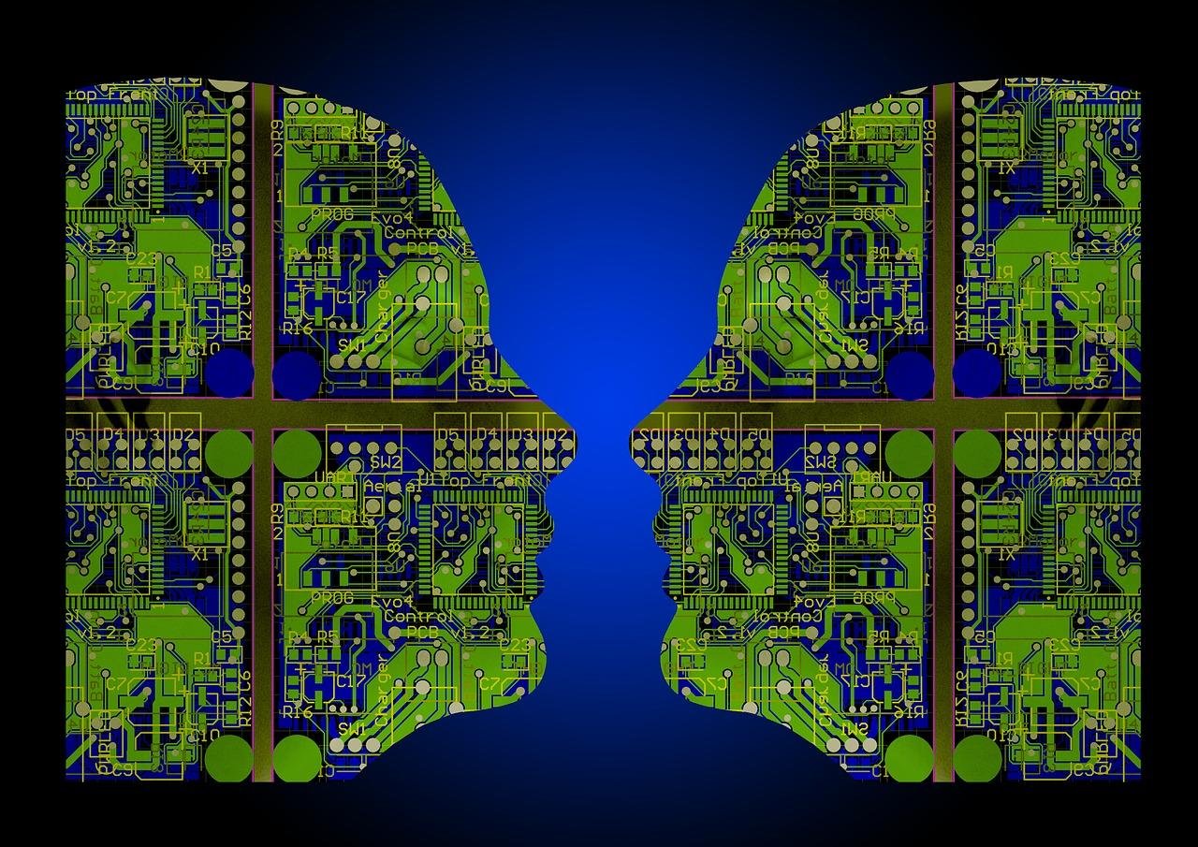
About project: gaming with reinforcement learning
Long-term plan: To be added
beyond gaming
Project on reinforcement learning
Requirements:
  a) programming skills/project experience
  b) interests in artificial intelligence
gaming with reinforcement

Slide 13
Thank You!
Contact: weiweiwu@seu.edu.cn 15195942422

